Slide 1
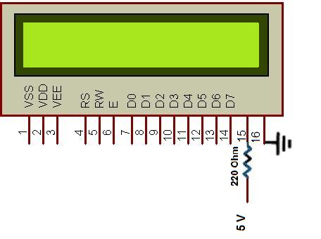
LCD Interfacing

Slide 2
LCD Interfacing
Liquid Crystal Displays (LCDs)
cheap and easy way to display text
Various configurations (1 line by 20 X char upto 8 lines X 80 ).
Integrated controller
The display has two register
command register
data register
By RS you can select register
Data lines (DB7-DB0) used to transfer data and commands

Slide 3
Alphanumeric LCD Interfacing
Microcontroller
Pinout
8 data pins D7:D0
RS: Data or Command Register Select
R/W: Read or Write
E: Enable (Latch data)
RS – Register Select
RS = 0 → Command Register
RS = 1 → Data Register
R/W = 0 → Write , R/W = 1 → Read
E – Enable
Used to latch the data present on the data pins.
D0 – D7
Bi-directional data/command pins.
Alphanumeric characters are sent in ASCII format.
E
communications bus
R/W
RS
DB7–DB0
8
LCD controller
LCD Module

Slide 4
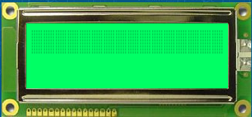
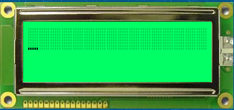

LCD Working
instr ( 0x0F ) ;
instr ( int i ) {
RS = 1;
Enable = 1 ;
P1 = i ;
Enable = 0 ;
}
data ( ‘W’ ) ;
data ( int i ) {
RS = 0;
Enable = 1 ;
P1 = i ;
Enable = 0 ;
}

Slide 5
LCD Commands
The LCD’s internal controller can accept several commands and modify the display accordingly. These commands would be things like:
Clear screen
Return home
Decrement/Increment cursor
After writing to the LCD, it takes some time for it to complete its internal operations. During this time, it will not accept any new commands or data.
We need to insert time delay between any two commands or data sent to LCD

Slide 6
Pin Diagram
Pin No. | Name | Input / Ouput | Description
Pin no. 1 | V_{SS} | - | Power supply (GND)
Pin no. 2 | V_{CC} | - | Power supply (+5V)
Pin no. 3 | V_{EE} | - | Power supply to control Contrast
Pin no. 4 | RS | Input | 0 = Instruction input 1 = Data input
Pin no. 5 | R/W | Input | 0 = Write to LCD module 1 = Read from LCD module
Pin no. 6 | EN | Input / Output | Enable signal
Pin no. 7 | D0 | Input / Output | Data bus line 0 (LSB)
Pin no. 8 | D1 | Input / Output | Data bus line 1
Pin no. 9 | D2 | Input / Output | Data bus line 2
Pin no. 10 | D3 | Input / Output | Data bus line 3
Pin no. 11 | D4 | Input / Output | Data bus line 4
Pin no. 12 | D5 | Input / Output | Data bus line 5
Pin no. 13 | D6 | Input / Output | Data bus line 6
Pin no. 14 | D7 | Input / Output | Data bus line 7 (MSB)
Pin no. 15 | Backlight | Input | +5v for LED backlight (+5V)
Pin no. 16 | Backlight | Input | Ground for LED backlight (GND)

Slide 7
LCD Commands
Code (Decimal) | Code (Hex) | Command to LCD Instruction Register
1 | 0x01 | Clear display screen
2 | 0x02 | Return Home
4 | 0x04 | Decrement cursor (shift cursor to left)
6 | 0x05 | Increment cursor (shift cursor to right)
6 | 0x06 | shift display right
7 | 0x07 | shift display left
8 | 0x08 | Display off, cursor off
10 | 0x0A | Display off, cursor on
12 | 0x0C | Display on, cursor off
14 | 0x0E | Display on, cursor on
15 | 0x0F | Display on, cursor blinking
16 | 0x10 | Shift cursor position to left
20 | 0x14 | Shift cursor position to right
24 | 0x18 | Shift the entire display to the left
30 | 0x1C | Shift the entire display to the right
128 | 0x80 | Force cursor to the beginning of 1st line
192 | 0xC0 | Force cursor to the beginning of 2nd line
56 | 0x38 | 2 lines and 5 x 7 matrix

Slide 8
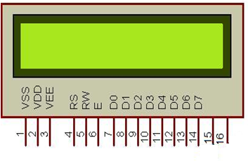
Circuit Diagram
GND – Pin 1,3,5,16
Vcc – Pin 2, 15
Microcontroller Pins
RS - P3.1
E – P3.2
P2
+5v – Vcc

